Slide 1
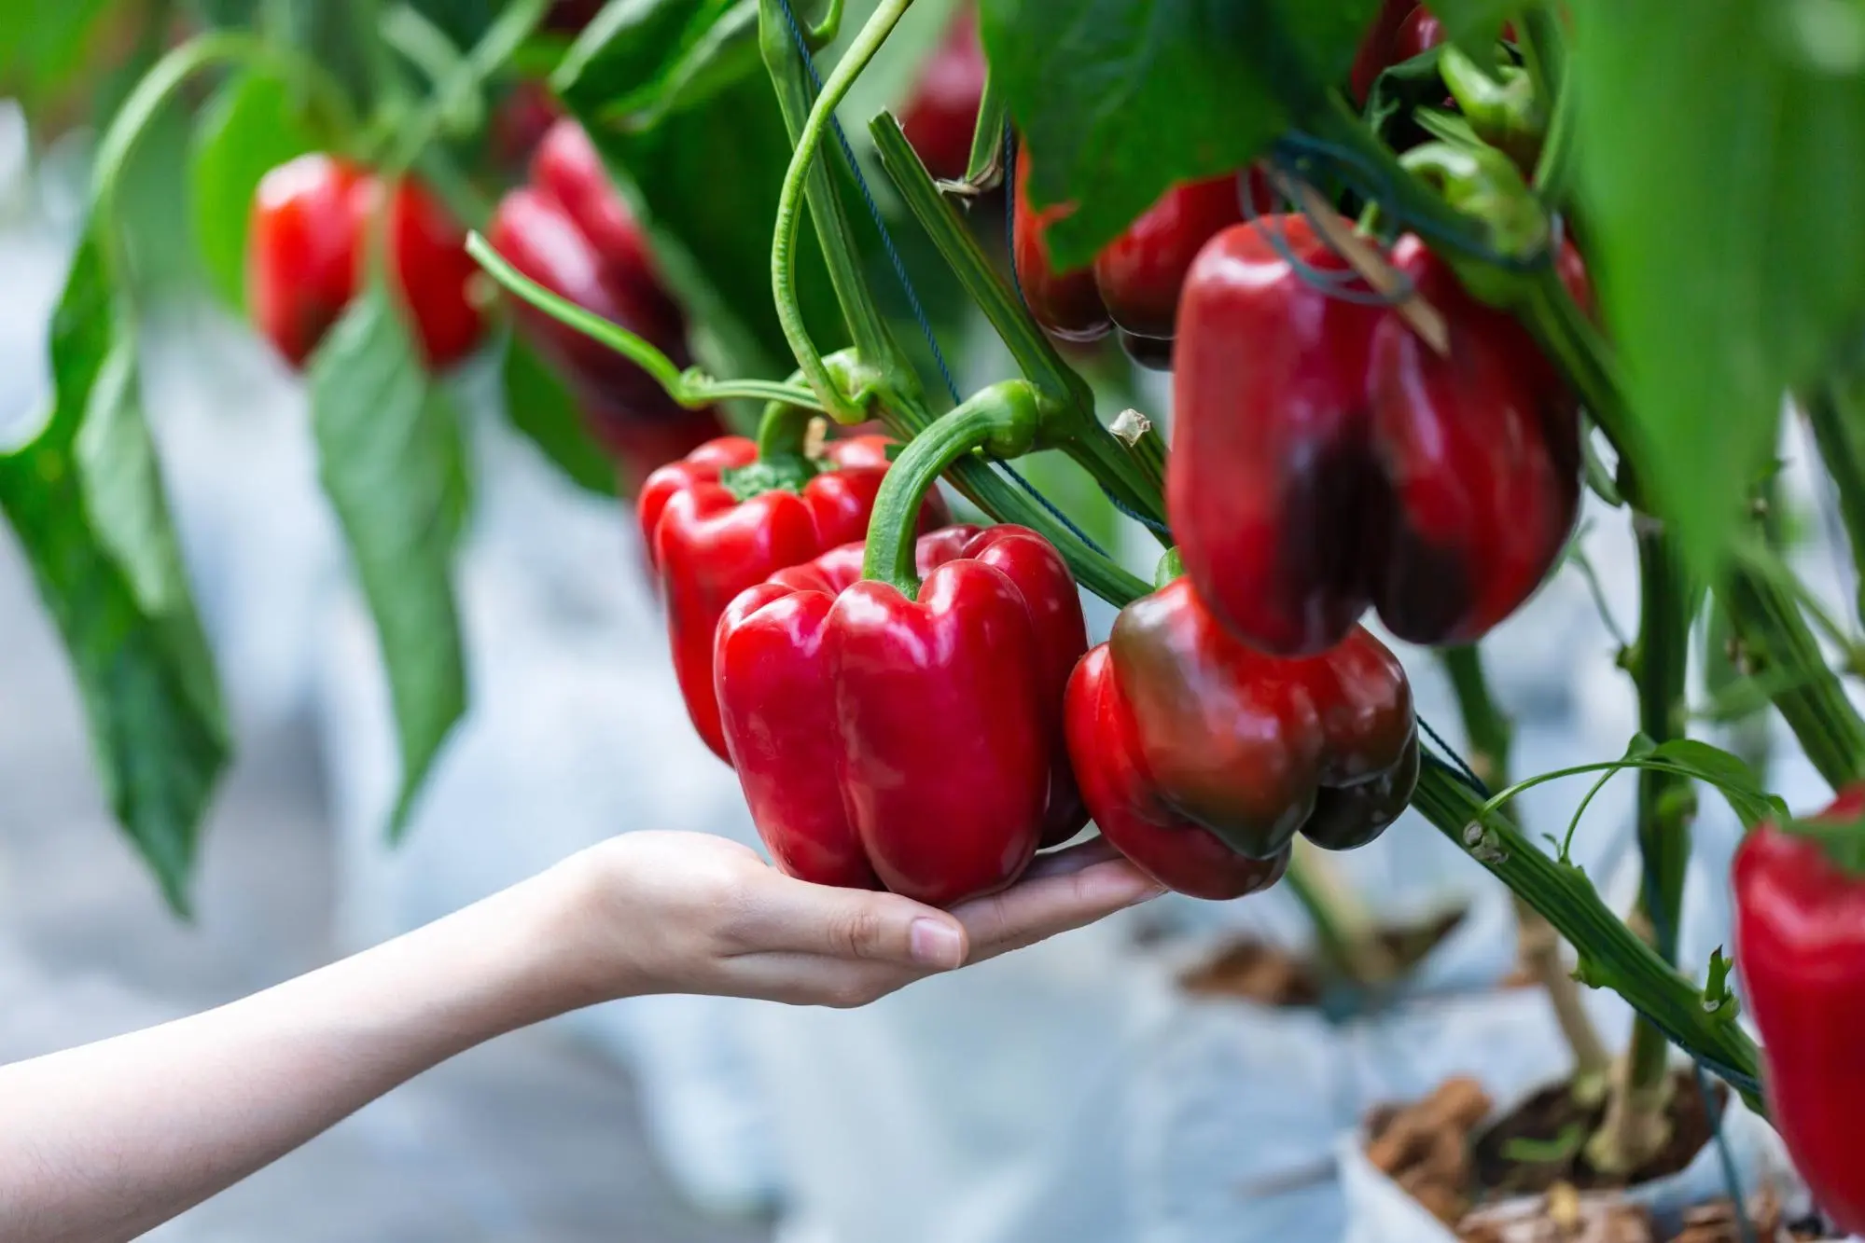
Garden-Bot
Team Members:
Carlos Navarro
Antonio Cantu
Sushmitha Susan Joseph

Slide 2
Objective
Design a commercially viable autonomous harvester which has potential benefits of:
Reducing labour costs
Optimising crop quality &
Improving the sustainability of farming enterprises
Integrate subsystems for detection (determining the presence/location), grasp selection (selecting appropriate grasping and/or cutting points) and manipulation (detaching the crop from the plant)

Slide 3
Background and Motivation
The robot will harvest sweet peppers grown in a greenhouse.
Peppers are ready for harvest between 8.5-13 weeks after planting.
Ripe peppers are relatively easy to pluck
Assuming 100 workers working for 8 hours a day for a month costs $287520

Slide 4
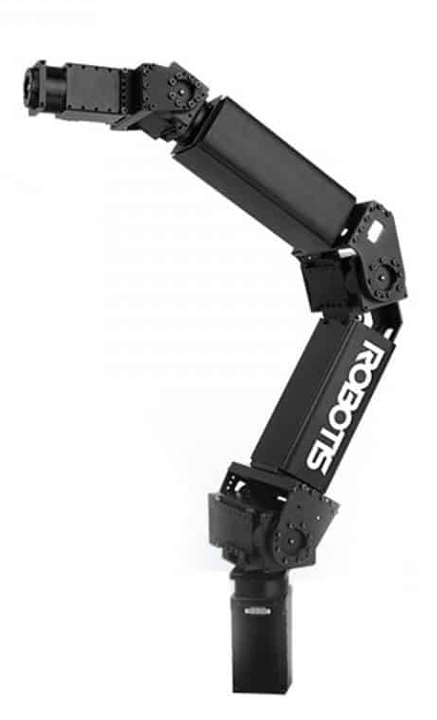
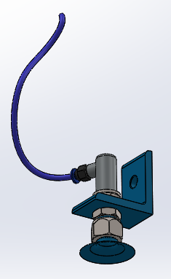
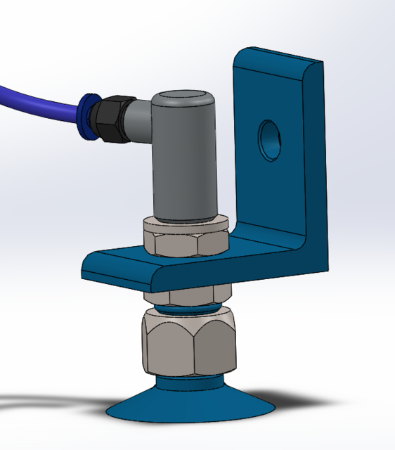
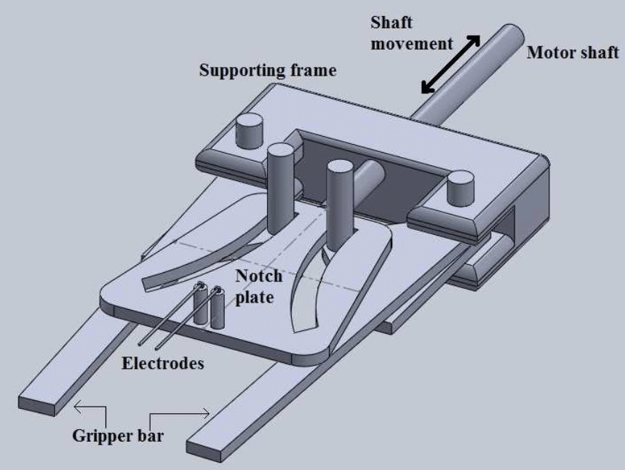
Research Design
Final manipulator being used is from Solvelight Robotics, it is a 6-DOF arm weighing about 5.5 kg.
Will be mounted on a vertical lift on a moving platform
Suction end effector will be mounted on the end of the manipulator
To help separate the crop from the plant a thermal cutter will be mounted on the suction end effector.

Slide 5
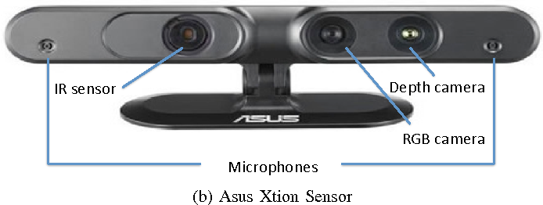
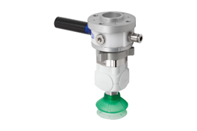
Methods
Background & rationale behind each sensor & actuator:
Vision-based automation done through RGB-D (Kinect-style) camera mounted on top of the end effector.
Reason: capture RGB images along with per-pixel depth information. Acquires multiple images of the red pepper through this camera from multiple viewpoints and uses it to build a complete 3D model. Low-cost camera
To grasp and cut the red pepper, two actuators combined into a decoupling mechanism.
Suction cup along with a vacuum hose. To grasp the red pepper firmly and hold it all throughout the cutting phase [5].
After attachment is complete, a Thermal Cutter removes the fruit from the stem.
Pressure sensor. Reason: detect successful attachment.
Notes:
Carlos

Slide 6
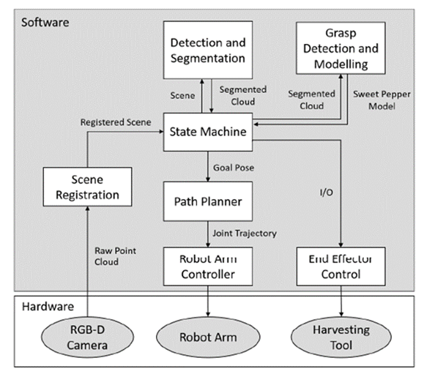
Multiple processes and algorithms interact with one another (often simultaneously). ROS to control this entire Garden-Bot system. Reason:
- Communication between processes.
- Nodes can be taken and spread across different places or into the same computer.
Node: low-level computational process. Within one node you have three standard interfaces: Topics, services, and actions.
topic messaging structure used to receive and send messages. communications and data happen back and forth between nodes.
services: Nodes can host services that ask a node to do something.
- Standard applications like navigation or movement, allows for a jointed arm to move to a certain location. Applications have been exposed to ROS, so easy to implement in Garden-Bot.
- ROS allows for multiple programming languages to get combined within Garden-Bot and they all talk through nodes.
Garden-Bot’s Harvesting Algorithm - Node’s Diagram [5]

Slide 7
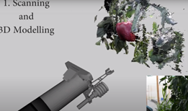
Scene Registration Node:
Moves the robotic arm in a pre-programmed scanning motion. RGB-D to create a 3D model of the scene.
Structured light technique to generate real-time depth maps containing discrete range measurements of the physical scene. This data is reprojected as a set of discrete 3D points (or point cloud) [5] [8]. Creates a complete 3D model.
Different viewpoints of the physical scene must be captured and fused into a single representation. Node uses Kinetic Fusion software. Reason:
Picks up Kinect camera and move rapidly within a room to reconstruct 3D model of scene.
Continuously tracks the 6DOF pose of the camera and fuses live depth data from the camera into a single global 3D model in real-time.
Figure: Scanning & Unsegmented 3D Model [5]

Slide 8
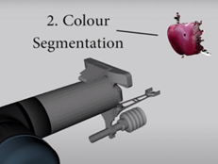
Detection & Segmentation Node:
service client node that detects sweet peppers within a scanned scene. This node returns a list of point cloud segments as output [5] [8].
Node scans a specific red pepper rather than the entire scene.
Kinect Fusion allows a user to first reconstruct the entire scene, and then segment the desired object. The red pepper is cleanly segmented from the background model
Figure: Segmentation of the 3D Model [5]

Slide 9
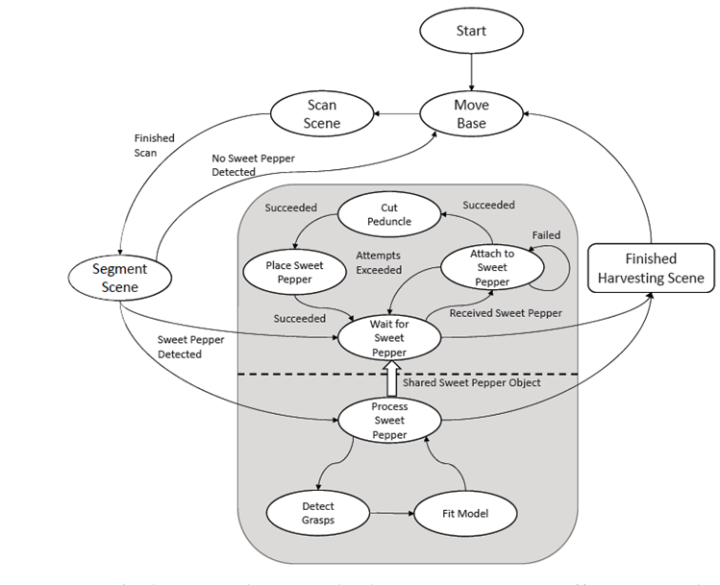
State Machines (After segmentation node there are 2 State Machines):
- They are groups of nodes; each node represents the state of the system [6].
- Edges represent transitions between states
- The labels in these edges, represent events and actions.
FIRST STATE MACHINE (lower dotted line region)
- Uses of the now segmented red pepper model to calculate candidate grasping and cutting poses [8] [5].
- Grasp poses are calculated using the segmented 3D point cloud.
A desirable grasp pose could be placing the suction cup squarely on the planar side of the pepper. A way to do this Fitting a geometric model (superellipsoid) to the point cloud to estimate the sweet peppers size, position, and orientation [5].
- Grasp pose = center of the front face of the pepper,
- Cutting pose = offset from the top face of the pepper.
Figure : Garden-Bot’s State Machines [5]

Slide 10
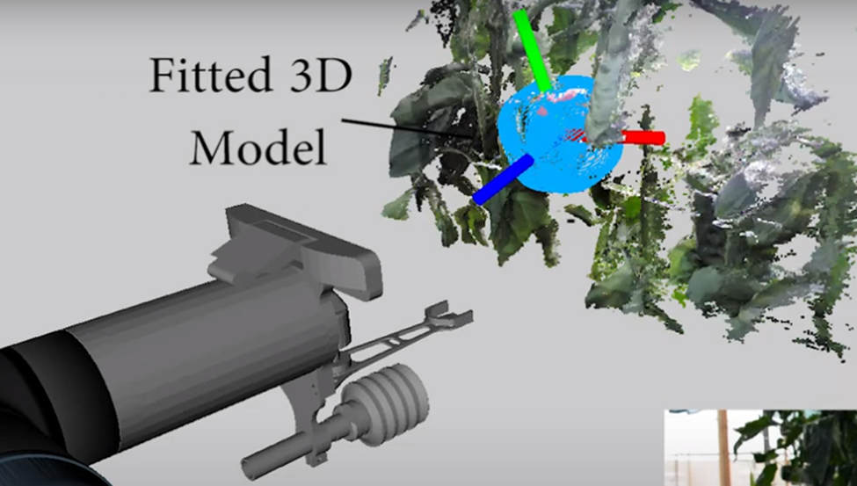
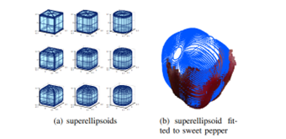
SECOND STATE MACHINE (upper dotted line) - Physical Harvesting
- Uses same segmented 3D model
- Path planner, robot arm controller and an end effector controller subsystem
- Harvesting trajectories calculated relative to grasping and cutting poses from previous machine.
- Attachment trajectory starts at a fixed offset back from the grasping pose and moves the suction cup along the selected approach axis.
- After attachment, decouple the suction cup from the cutting tool.
- Lastly, a cutting trajectory is computed. Failure to attach the suction is detected using pressure sensor and triggers a reattachment at next-best grasp candidate.
- Garden-Bot employs MoveIt. Reason:
Great tool for planning motions between points in space [9].
Hand-eye calibration determines the transform between the camera and the end-effector.
Uses the segmented red pepper 3D model for optimizing the calibration parameters.
Figure: Super ellipsoid fitted to the 3D model and cutting and grasping poses identified [5]
Figure : The range of super ellipsoids which are used to fit to sweet peppers [8]

Slide 11
Evaluation Plans
Testing & Experimental Results:
Fixed number of pepper plants. Some ready to get collected, and some not fully red and therefore not ready to be picked by our robot.
Run several harvesting trials. Each trial starts with same number of fixed initial available peppers.
Recorded Information:
Initial number of peppers used in all trials.
Number of ready to harvest red peppers that were not picked up due to attachment failure.
Number of ready to harvest red peppers that were not picked up due to detachment failure.
Total sum of ready to harvest red peppers that were not picked up.
Total number of not ready to harvest peppers (not red enough) that were picked up.
Total number of red peppers that were picked up and got damaged.
Using the previous data, the following metrics could give a good taste of Harvesting Performance:
overall success rate
attachment success rate
detachment success rate
handling success rate
overall scanning success rate, and scanning the ready-to pick peppers success rate.

Slide 12
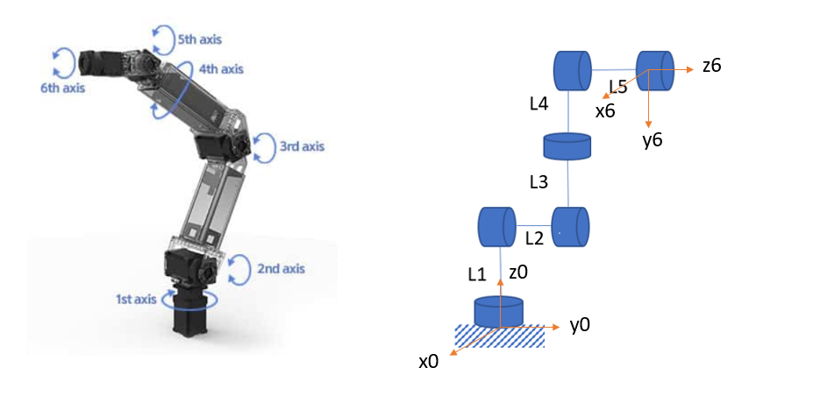
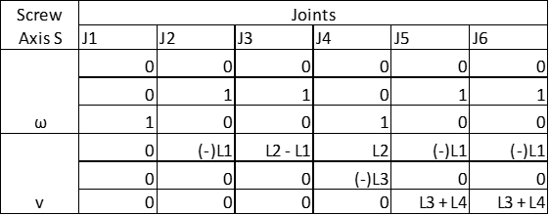
Forward Kinematics:
ω1 = ω4 = [ 0 0 1 ] ^{T}
ω2 = ω3 = ω5 = ω6 = [ 0 1 0 ] ^{T}
For home configuration, θ = 0 for all joints,
T₆₀ = 1 0 0
0 0 1
0 -1 0
P2 = [ 0 0 L1 ]^{T}
P3 = [ 0 L2 L1 ]^{T}
P4 = [ L3 L2 L1 ]^{T}
P5 = [ L3+L4 L2 L1 ]^{T}
P6 = [ L3+L4 L2+L5 L1 ]^{T}
T₆₀ (θ) = e ^{S1θ1} e ^{S2θ2} e ^{S3θ3} e ^{S4θ4} e ^{S5θ5} e ^{S6θ6}

Slide 13
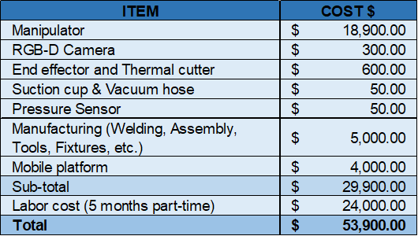
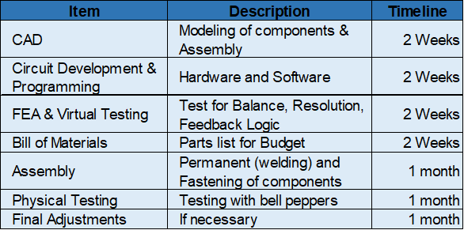
Budget and Timeline

Slide 14
References Cited:
[1] “Greenhouse Growing Guide: Peppers.” Www.btlliners.com, www.btlliners.com/greenhouse-growing-guide-peppers. Accessed 6 Dec. 2022.
[2]COSTS and PROFITABILITY ANALYSIS for BELL PEPPER PRODUCTION in the OXNARD PLAIN, VENTURA COUNTY, 2012-13 Bell Pepper Production for Processing.
[3] “ROBOTIS MANIPULATOR-H ROBOTIC MANIPULATOR.” Solvelight Robotics, solvelight.com/product/robotis-manipulator-h-robotic-manipulator/. Accessed 6 Dec. 2022.
[4] “Free CAD Designs, Files & 3D Models | the GrabCAD Community Library.” Grabcad.com, grabcad.com/library/suction-cup-ventouse-1. Accessed 6 Dec. 2022.
[5] Christopher L., Andrew E., Christopher Mc., Adam W., and Tristan P., “Autonomous Sweet Pepper Harvesting for Protected Cropping Systems” in IEEE Robotics and Automation Letters, 2017.
[6] Udacity. “Finite State Machines - Georgia Tech - Software Development Process.” [Video file]. YouTube, 23 Feb. 2015, https://www.youtube.com/watch?v=2xbWwk4-zTs.
[7] ROS. “An Introduction to ROS, the Robot Operating System: Intro to ROS (2/6)” [Video file]. YouTube, May. 2020, https://www.youtube.com/watch?v=96XsJ7xfsS8.
[8] C. Lehnert, I. Sa, C. Mccool, B. Upcroft, and T. Perez, “Sweet Pepper Pose Detection and Grasping for Automated Crop Harvesting,” in IEEE International Conference on Robotics and Automation (ICRA), 2016.
[9] ROS. “MoveIt Capabilities Overview” [Video file]. YouTube October 13). Retrieved December 4, 2022, from https://www.youtube.com/watch?v=7KvF7Dj7bz0&t=1s
[10] Shivaji B., Koichi O., “Performance Testing of Thermal Cutting Systems for Sweet Pepper Harvesting Robot in Greenhouse Horticulture” Journal of System Design and Dynamics, 2013.

Slide 15
Questions?

